Slide 1
Introduction to the C# Language and the .NET Framework
Chapter-1

Slide 2
Visual Studio and the .NET programming languages

Slide 3
Microsoft Visual Studio
Microsoft Visual Studio is an Integrated Development Environment (IDE) from Microsoft.
It is used to develop computer programs, as well as web sites, web apps, web services and mobile apps.

Slide 4
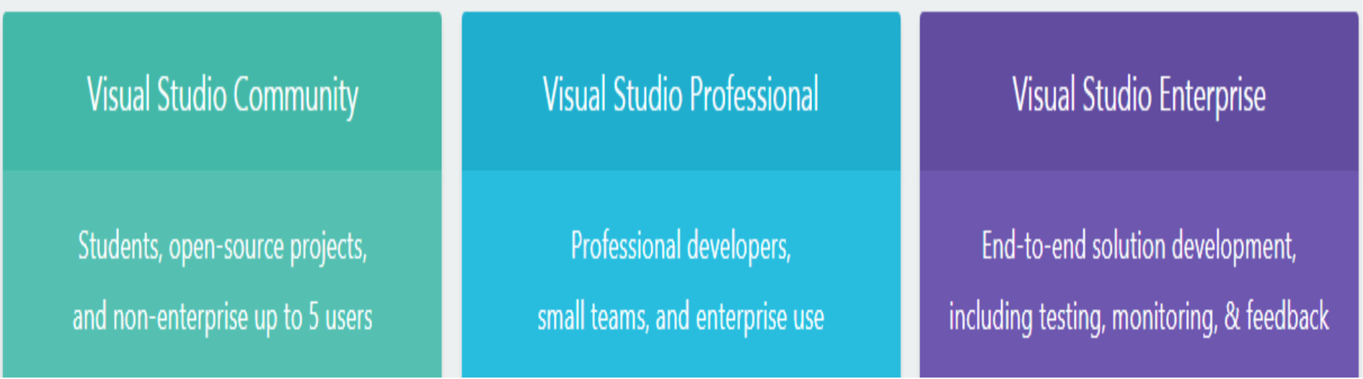
Visual studio 2017 editions
https://visualstudio.microsoft.com/vs/compare/

Slide 5
Programming languages supported by Visual studio
Visual Studio supports many different programming languages and allows the code editor and debugger to support (to varying degrees) nearly any programming language.
Built-in languages include C++, Visual Basic .NET, C#, F#, JavaScript, XML, HTML and CSS.
Support for other languages such as Python, Ruby, PHP among others is available via plug-ins.

Slide 6


Slide 7
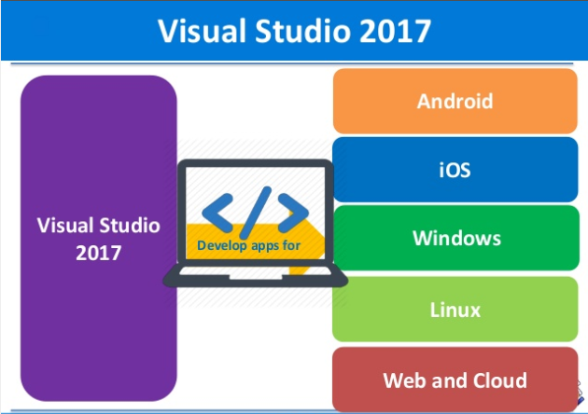

Slide 8
An introduction to the .net framework

Slide 9
What is the .NET Framework?
The .NET Framework is a runtime execution environment for Windows that provides a variety of services to its running apps.
It consists of two major components:
The Common Language Runtime (CLR), which is the execution engine that handles running apps,
The .NET Framework Class Library, which provides a library of tested, reusable code that developers can call from their own apps.

Slide 10
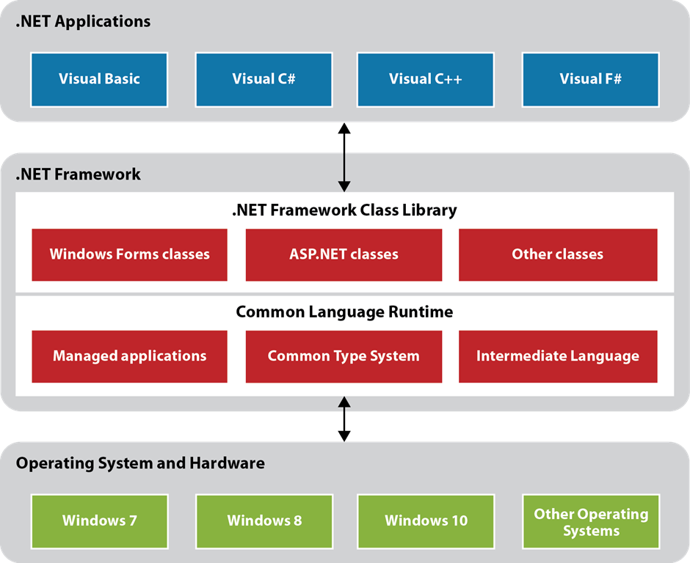

Slide 11
Description
Windows Forms applications do not access the operating system or computer hardware directly.
Instead, they use services of the .NET Framework, which in turn access the operating system and hardware.

Slide 12
Description
The classes in the .NET Framework Class Library are organized in a hierarchical structure. Within this structure, related classes are organized into groups called namespaces.
Each namespace contains the classes used to support a particular function. For example, the System.Windows.Forms namespace contains the classes used to create forms and the System.Data namespace contains the classes you use to access data.
Notes:
Like packages in Java

Slide 13
Description
The Common Language Runtime, or CLR, manages the execution of .NET programs by coordinating essential functions such as memory management, code execution, security, and other services. Because .NET applications are managed by the CLR, they are called managed applications.
All of the .NET languages compile to a common intermediate language
The Common Type System is a component of the CLR that ensures that all .NET applications use the same basic data types no matter what programming languages are used to develop the applications.
Notes:
The Common Type System (CTS) standardizes the data types of all programming languages using .NET under the umbrella of .NET to a common data type for easy and smooth communication among these .NET languages. How CTS converts the data type to a common data type
To implement or see how CTS is converting the data type to a common data type, for example, when we declare an int type data type in C# and VB.Net they are declared as Integer.Then they are converted to int32. In other words, now both will have a common data type that provides flexible communication between these two languages.

Slide 14
What is C#?
C# is an object-oriented language that enables developers to build a variety of secure and robust applications that run on the .NET Framework.
Its development team is led by Anders Hejlsberg.
You can use C# to create Windows client applications, Web services, client-server applications, database applications, and much more.
Notes:
C# was designed by Anders Hejlsberg, and its development team is currently led by Mads Torgersen. The most recent version is C# 7.3, which was released in 2018 alongside Visual Studio 2017 version 15.7.2. .NET Framework version – 4.7

Slide 15

Why C#?
C# has many other reasons for being popular and in demand. Few of the reasons are mentioned below:
Easy to start: C# is a high level language so it is closer to other popular programming languages like C, C++, and Java and thus becomes easy to learn for anyone.
Widely used for developing Desktop and Web Application: C# is widely used for developing web applications and Desktop applications. It is one of the most popular languages that is used in professional desktop. If anyone want to create Microsoft apps, C# is the go to language.
Community: C# has a large community so the developments are done to make it exist in system and not become extinct.
Game Development: C# is widely used in game development and will continue to dominate. C# integrate with Microsoft and thus has a large target audience.

Slide 16
How a C# application is compiled and run
To start, you use Visual Studio to create a project, which is made up of source files that contain C# statements. A project may also contain other types of files, such as sound, image, or text files.
After you enter the C# code for a project, you use the C# compiler, which is built into Visual Studio, to build (or compile) your C# source code into Microsoft Intermediate Language (MSIL). For short, this can be referred to as Intermediate Language (IL).

Slide 17
How a C# application is compiled and run
At this point, the Intermediate Language is stored on disk in a file that's called an assembly. In addition to the IL, the assembly includes references to the classes that the application requires. An assembly is an executable file that has an .exe or .dll extension.
The assembly can then be run on any PC that has the Common Language Runtime installed on it. When the assembly is run, the CLR converts the Intermediate Language to native code that can be run by the Windows operating system.
Incidentally, a solution is a container that can hold one or more projects. Although a solution can contain more than one project, the solution for a simple application usually contains just one project. In that case, the solution and the project are essentially the same thing.

Slide 18
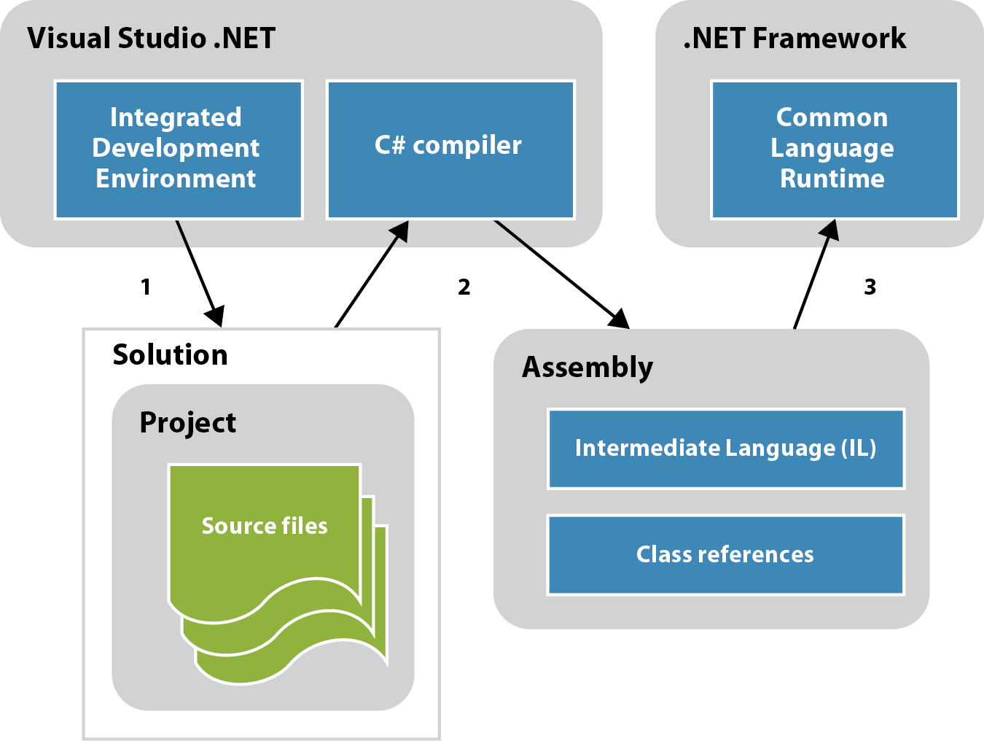
How a C# application is compiled and run

Slide 19
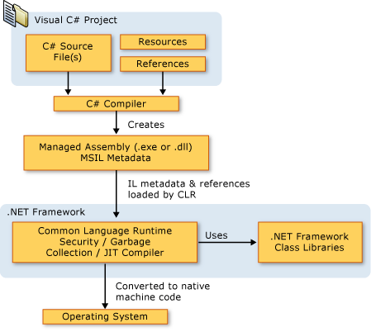
Notes:
When the C# program is executed, the assembly is loaded into the CLR, which might take various actions based on the information in the manifest. Then, if the security requirements are met, the CLR performs just in time (JIT) compilation to convert the IL code to native machine instructions. The CLR also provides other services related to automatic garbage collection, exception handling, and resource management. Code that is executed by the CLR is sometimes referred to as "managed code," in contrast to "unmanaged code" which is compiled into native machine language that targets a specific system. The following diagram illustrates the compile-time and run-time relationships of C# source code files, the .NET Framework class libraries, assemblies, and the CLR.
In addition to the run time services, the .NET Framework also includes an extensive library of over 4000 classes organized into namespaces that provide a wide variety of useful functionality for everything from file input and output to string manipulation to XML parsing, to Windows Forms controls. The typical C# application uses the .NET Framework class library extensively to handle common "plumbing" chores.

Slide 21
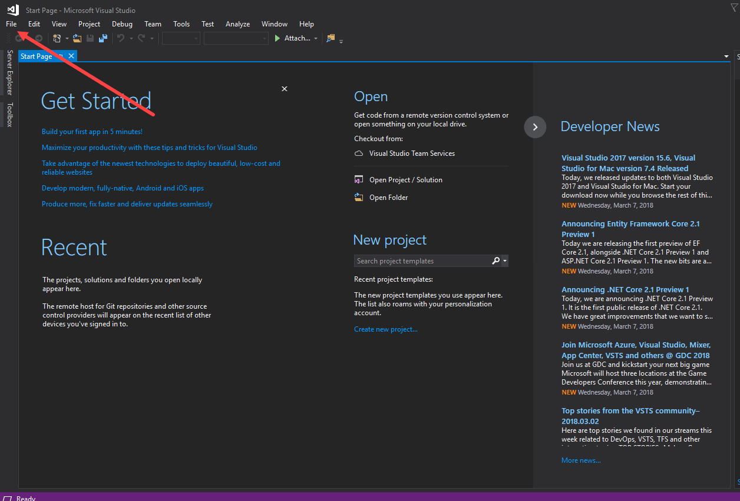
In Visual Studio IDE, you can navigate to File menu to create new C# applications.

Slide 22

The Open Project dialog box

Slide 23
Project and solution concepts

Slide 24
User interface

Slide 25
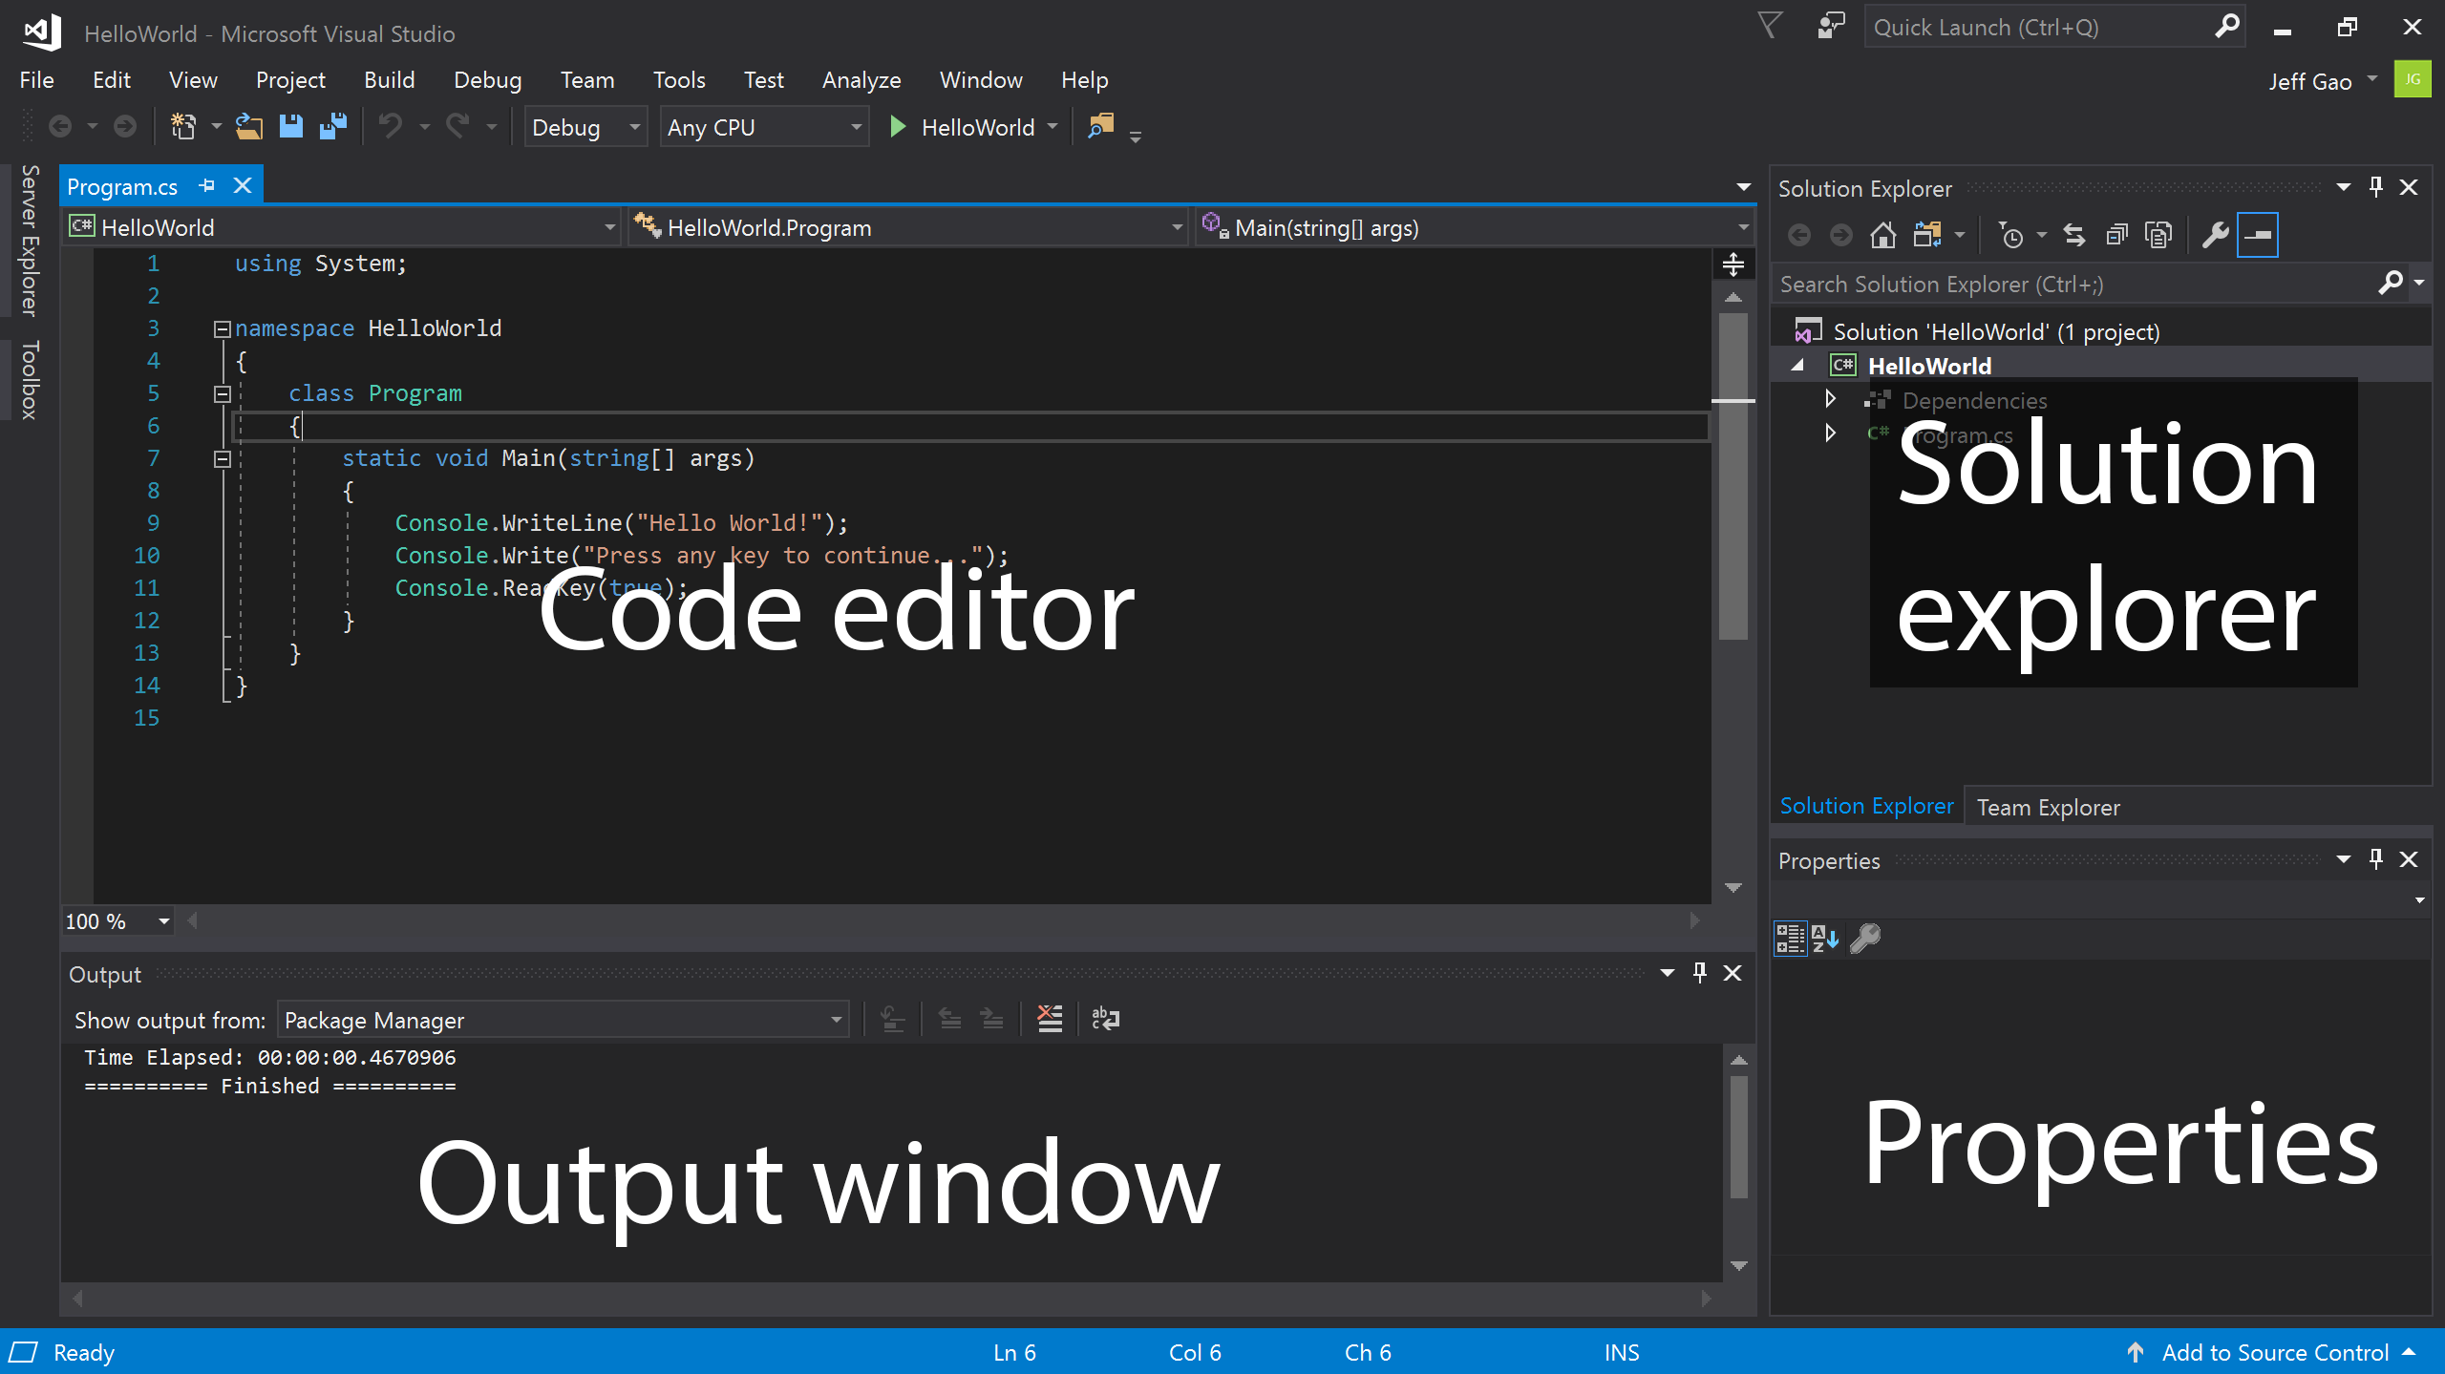
The Form Designer window of Visual

Slide 26
Description
The Code editor is where you write your code.
The Solution explorer shows the files you’re working with.
The Properties pane gives additional information and context about selected parts of your project.
The Output window displays debugging and error messages, compiler warnings, status messages, and other output.
You can add additional tool windows by using the View menu at the top. The layout of your tool windows is highly customizable — you can add additional windows, remove the ones you have open, and move them around to best suit how you work.

Slide 27
Menus
At the top of the screen, you’ll see Visual Studio’s menus, which you’ll use to run various commands. Here’s a high level overview of the most important ones:

Slide 28
Menus
The File menu contains commands to create, open, and save projects.
The Edit menu contains commands to search, modify, and refactor your code.
The View menu is where you go to open additional tool windows in Visual Studio.
The Project menu lets you add files and dependencies in your project.
The Debug menu contains commands to run your code and use debugger features.
The Tools menu contains commands to change your settings, add functionality to Visual Studio via extensions, and access various Visual Studio tools.

Slide 29
Toolbar
The Visual Studio toolbar, shown below the menus, provides quick access to the most common commands.
You can change what commands the toolbar contains by going to View → ToolBars

Slide 30
How to use the solution explorer

Slide 31
Notes:
These files contain resource files that are used by applications that have been developed using the Microsoft.NET framework. The RESX files that are created with this framework contain strings and objects for an associated program, saving the information in the XML file format.

Slide 32
Project files

Slide 33
Project files (cont.)

